Slide 1
Software Engineering II Presentation
Software Maintenance

Slide 2

Software Maintenance
Team Presentation.
Why Maintenance?
Problems of Maintenance.
Design a Software to ease Maintenance.
Conclusion.

Slide 3
Why Maintenance?
Definition of Maintenance,
Software Maintenance Objectives,
Enterprise Resource Planning .

Slide 4
Definition of Maintenance
Is the set of activities, both technical and managerial, that ensures that software continues to meet organizational and business objectives in a cost effective way.

Slide 5

Software Maintenance Objectives
Difference between Software Product and Software Maintenance is:
  Software Product is the result of the Software development.
  Software Maintenance results in a service being delivered to the customer.

Slide 6
Software Maintenance Objectives
Corrective,
Adaptive,
Perfective,
Inspection.

Slide 7
Types of Maintenance
Corrective:
  Taking existing code and correcting a fault that causes the code to behave in some way that deviates from its documented requirements.

Slide 8
Types of Maintenance
Adaptive:
  Taking existing code and adapting it to provide new features and functionality. These are typically part of a new release of the code and part of a larger development effort.

Slide 9
Types of Maintenance
Perfective:
  These are typically made to improve the maintainability of the code such as restructuring it to make it more easily understood or to remove ambiguities.

Slide 10
Types of Maintenance
Inspection:
  These are usually made as a result of code inspections and focus more of adhering to coding standards or to reduce the likelihood of a failure.

Slide 11
Enterprise Resource Planning
ERP is a perfective strategy planning for most software application domains which look forward to the point where their software can be developed from existing architectures, frameworks, patterns and components.

Slide 12
Resource Planning objectives
Solve future business application problems,
Integrate those solutions across the enterprise.

Slide 13
Problems of Maintenance
Maintenance Attributes,
Maintenance Organization,
Respect of Metrics,
Requirements volatility.

Slide 14
Maintenance Attributes
five factors drive the difficulty of delivering software:
  Product ,
  Documentation,
  End users,
  Process,
  Environment.

Slide 15
Maintenance Attributes
Important attributes to be considered during Maintenance:
  product age,
  design,
  Language,
  current failure rate,
  staff experience.

Slide 16
Maintenance Organization
five factors drive the difficulty of delivering software:
  Input Vs. output,
  cycle-time,
  cost/change,
  schedule,
  flexibility,
  Quality.

Slide 17
Respect of Metrics
Software maintenance should be measured and managed using metrics to reach a quality software.
However, we don't know how to measure maintainability because it’s a service.
Approaches were made to get values that can be useful during maintenance (surveys).

Slide 18
Survey
Ex 1
Ex 2
Ex 3
Throughput (Changes Delivered)
209
846
139
Priority Change Response Time (Days)
111
92
108
Economics (K$/Change)
78
116
45
% Releases w/Content Changes (total releases)
33
75
65
% Schedules Met
100
70
24
Customer-Reported Defects per Change Delivered
51
21
4

Slide 19
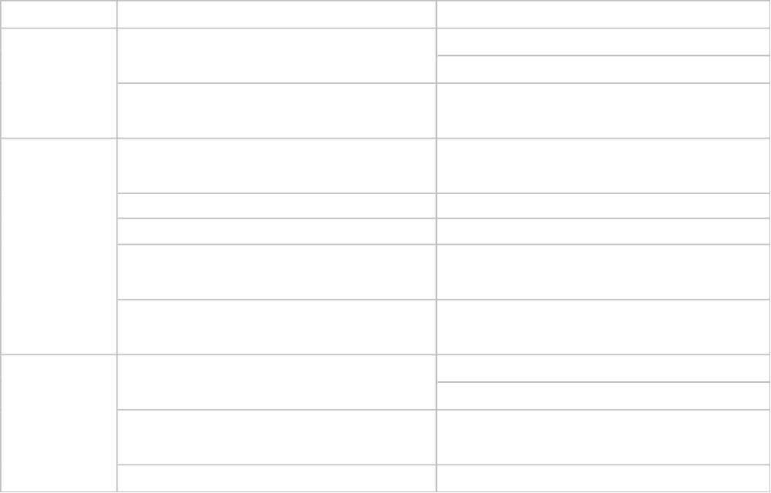

Slide 20
Requirements volatility
Requirements are the foundation of the software release process.
  Changing requirements during the software maintenance process impacts the cost, schedule, and quality of the resulting product.
  Build model to make planning of customer communications (predictions).
A focus is made on non volatile requirements.

Slide 21
Design for Maintenance
A strategy to set a certain rules during the Software development.
It eases the maintability of the system.

Slide 22
Design Attributes
Three main Factors that we have to ensure during the design of the Software:
  Understandability,
  Modifiability,
  Stability.

Slide 23
Design Strategies
Reasons to do a good Design in order to ease maintability:
  Low Cost for future maintenance,
  Avoid long time periods of maintenance,
  Ability to discover rapidly the failures.

Slide 24
Design Data Collection
Collecting some characteristics during the commencement of the project about :
  The Behavior of the requirements,
  Case tool and the Programming Language used,
  The environment.

Slide 25
Design for Maintenance
Emergency Rework on Modules
  Design independent modules in order to substitute them in failures and correct the deficiencies rapidly.
  Design a structure with independent components in order to be easy in maintenance

Slide 26
Tips to Be Memorized
Through many recommendations, we've noticed seven objections to action that are repeatedly raised:
  Challenges to definitions & terms,
  Different conclusions or effects,

Slide 27
Tips to Be Memorized Ctd’
  Interference,
  Different cause,
  Irrelevant reasons,
  Factor ignored,
  Counterexample.

Slide 28
Conclusion
It’s very hard to maintain a system than to design it.
It’s even harder to design a maintainable system, because it’s difficult to predict future changes in the business environment.
Software maintenance is a critical activity in the life cycle of a system.

Slide 29
References
http://www.kluweronline.com/issuetoc.htm/1022-7091+9+1/4+2000
http://www.cs.umd.edu/~sharip/wets/papers/
http://wwwsel.iit.nrc.ca/seldocs/eassedocs/WESS96Lethbridge.pdf
http://wwwsel.iit.nrc.ca/seldocs/eassedocs/WESS96Singer.pdf
http://wwwsel.iit.nrc.ca/seldocs/eassedocs/WESS97Lethbridge.pdf
http://www.dacs.dtic.mil/topics/reliability/annalse2.pdf
http://www.cs.umd.edu/~sharip/wess/papers/smith.html

